Slide 1
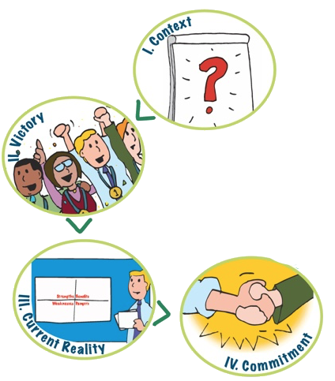
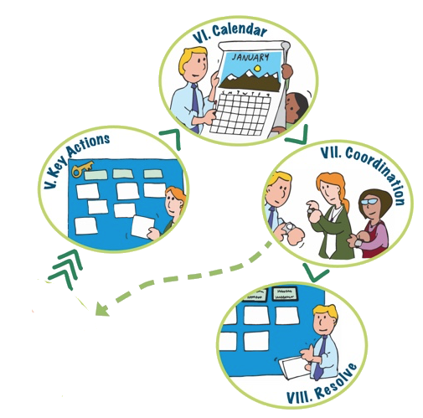
Action Planning Overview
Notes:
Action Planning employs 8 steps. For action planning to be effective, the group has to have already decided upon a project or event they want to do.
Step 1 Context - provides an overview of the process and identifies what has has been decided or is already established. It includes a brief focused conversation about the item to be planned to get people engaged, connecting with their relevant information and experience and to stimulate their thinking on the topic.
Step 2 Victory - Positions people in the future, right after the highly successful event, and asks them to look back on the event as they imagine success. We then ask objective questions that are relevant to the nature of the event or project – what did you see, hear, taste… who was there…what were the components….and add them as quickly as possible to a chart, using vibrant colors and random placement to add energy and excitement. All ideas are wanted here and broad diversity is good.
Step 3 Current Reality - Explores the Current Reality by first focusing on the team responsible for creating the event/project and identifies strengths and weaknesses of that team (R level). Then moves to identify Benefits and Dangers of Success (I level).
Step 4 Commitment - Informed by the aspirations captured in the Victory stage and current reality, the group determines what it is committed to do. This requires group consensus. The statement should be relatively high level (this is essentially defining the scope of work). If the group cannot agree here, the process ends.
Step 5 Key Actions – Uses a modified consensus workshop that organizes all the actions needed to reach the commitment by tasks that can be done by same team – resulting in identifying the teams that are needed and their scope.
Step 6 Calendar – Asks for individuals to self select into a team and, using ideas suggested during key actions, build a calendar for each team to reach their portion of the commitment.
Step 7 Coordination – Focuses the group on the calendar to identify where adjustments are needed, including any needed to achieve the commitment and explores how the group will stay coordinated
Step 8 Resolve – Reviews the plan, reaffirms the commitment, creates a celebratory spirit to deepen ownership of the plan and assures next steps are clear.

Slide 2
Action Planning in SNAP-Ed Time
Part 2
Part 1
Commitment

Slide 3
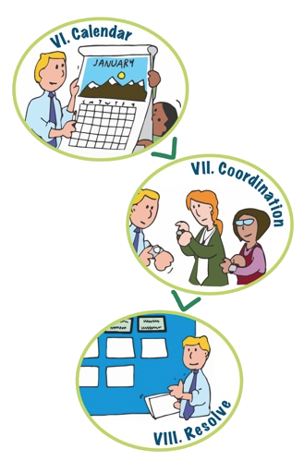
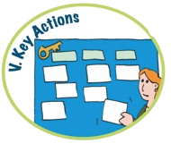
Another Possible Split
Part 1
Part 3
Part 2

Slide 4
Manage Time
2. Victory
Don’t dawdle
Speed charting with a scribe
Include idea from everyone
Write bigger to fill chart
Prepopulate with
comments from
prior discussions
1. Givens
Be meticulous in thinking through Givens to minimize time on things already decided.
Share what is known in advance
3. Current Reality
Get the essence – no need to be exhaustive
Manage with a few questions
4. Commitment
Take the time it takes.
Agreement is crucial.

Slide 5
6. Calendar
Write clear instructions
Have team “packets” ready
Create “competitive” spirit to get items posted
Team reporters limit commentary and present quickly and clearly
Limit questions to
clarity
7. Coordination
Ask teams to look for items they need from other teams and timing
Have teams compare team “Victory” to Commitment and identify anything missing.
5. Key Actions
Post question visibly
Give limited time and monitor it purposefully
Groups do key actions on their own
8. Resolve
Never skip
Plan in time to engage the group and celebrate success
Visibly chart next steps

Slide 6
Be Advised….
Engagement in the planning process is the basis for participant buy in. Excessive short cutting reduces ownership and buy-in.
Spreading parts across too many meetings means backing up and gaining input of new people and potential loss of energy

